Slide 1
Pricing Football Players using Neural Networks
Sourya Dey
Final Project - Neural Learning and Computational Intelligence
April 19th 2017, University of Southern California

Slide 2


How the Football Transfer Market Works
Nominal Price = $2 Million
Club A
Initial Bid = $2.2 Million
Club B
Asking Price = $2.5 Million
Can’t match asking price
Negotiate
Rival Bid = $2.1 Million
Club C
Counter Bid = $2.3 Million
SOLD for $2.4 Million
Potential youngster
International Star
Seal deal before transfer window closes!
Clinical goalscorer
Reliable defender

Slide 3
Money Talks
“
The January I moved from Birmingham to Blackburn, I sat there by the phone for 13 days, worrying, waiting for it to go through - I lost a stone.
”
-- Robbie Savage
Former Premier League Midfielder
Football Focus Special, 2011
Negotiations are a big part of football. What is the optimum price for a player?

Slide 4

Data Source: FIFA 2017
A football simulation video game with official licenses for most major teams and players in the world

Slide 5
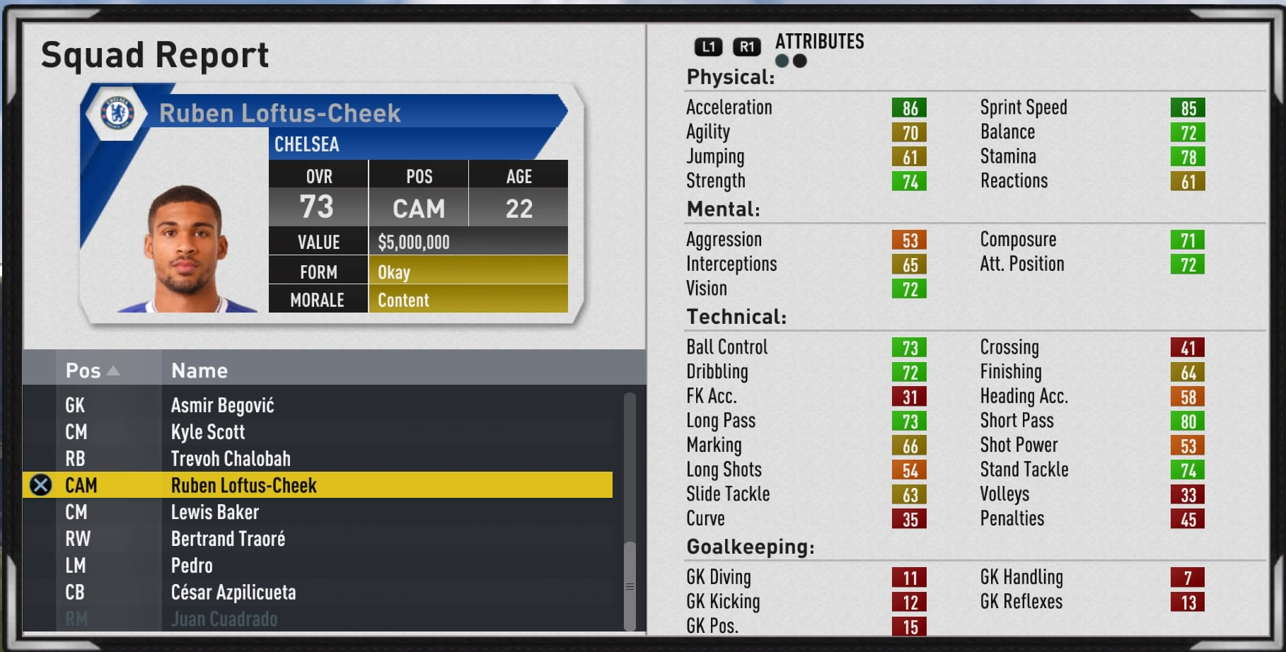
Player Attributes

Slide 6
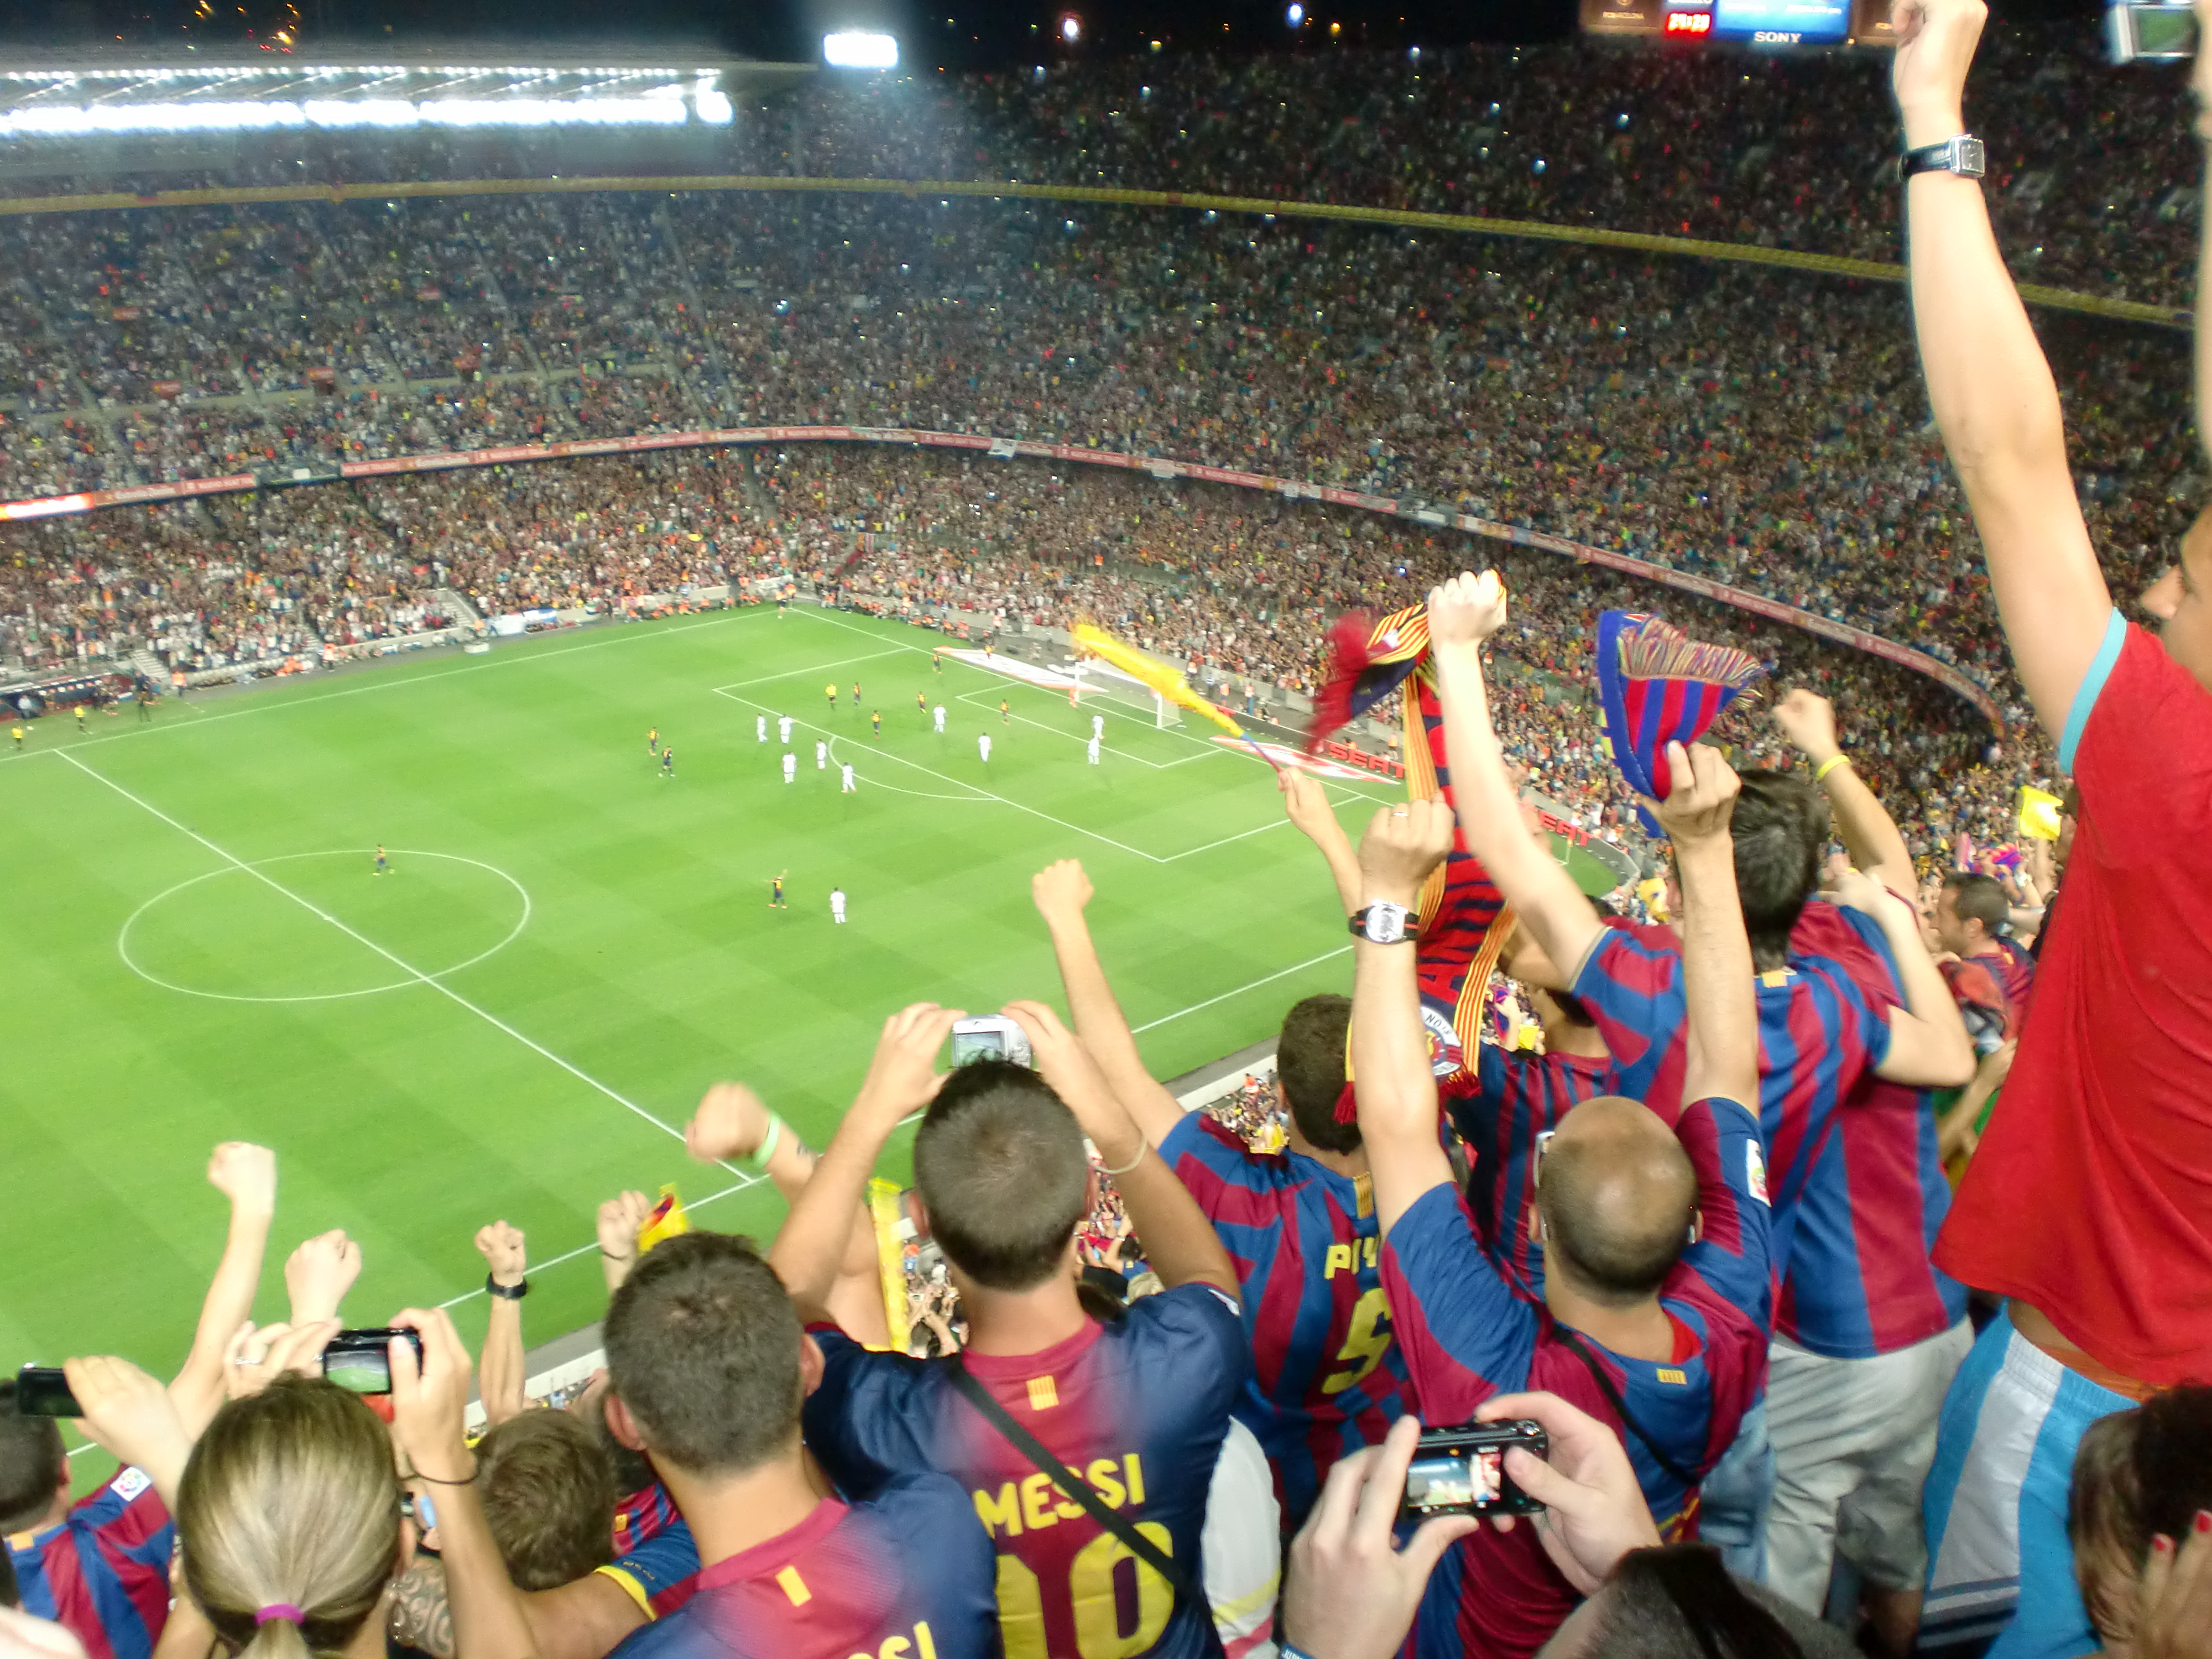



Authenticity of Data
Season Ticket Holders
300 data points per player
Feedback from 9000 data reviewers
Managers
Stats updated weekly on EA servers as per real-life performance
Scouts

Slide 7
Criticisms of Data Authenticity
Subjectivity by EA
Not enough data on fledgling players
Imperfect formula
“
If Messi were playing in the Irish league, his attributes would drop simply because he's not on the highest level anymore.
”
-- Michael Mueller-Moehring
EA Sports Producer and Ratings Specialist
Interview with ESPN FC, September 2016

Slide 8
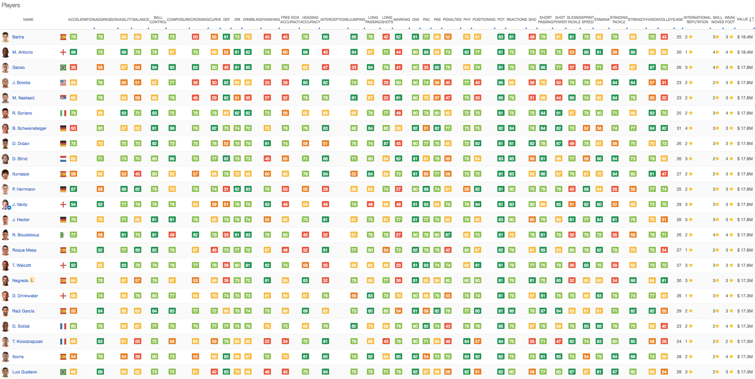
Gathering Data – sofifa.com

Slide 9
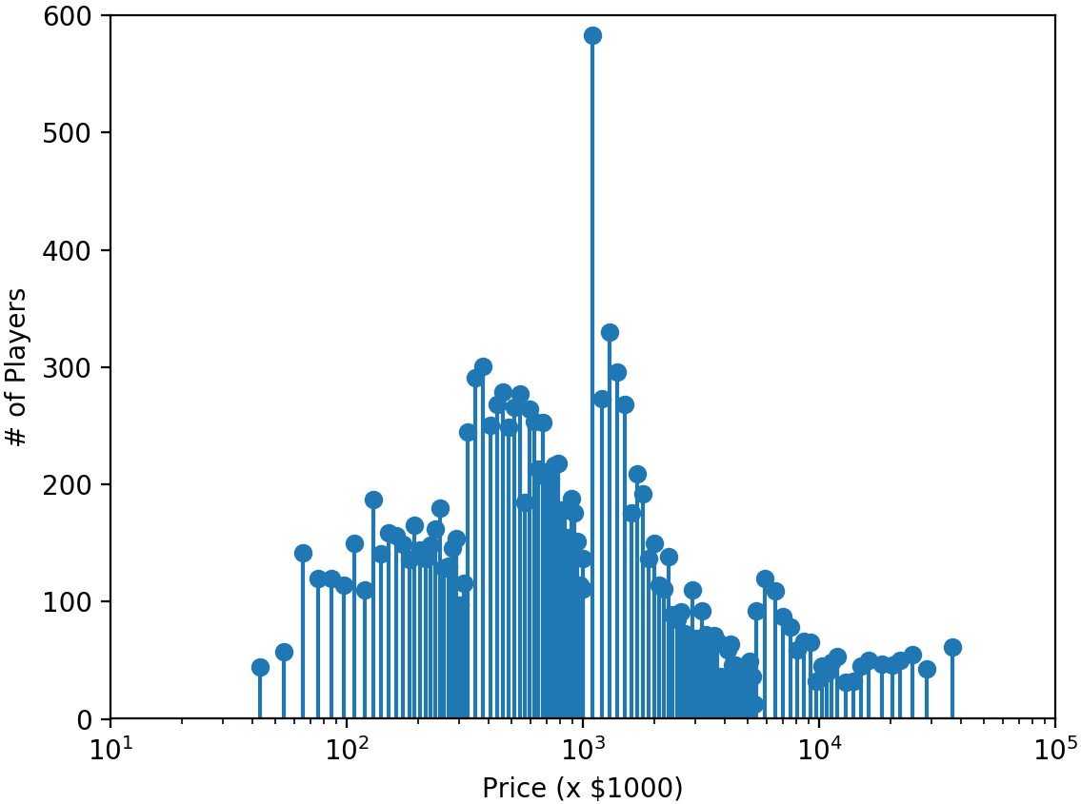
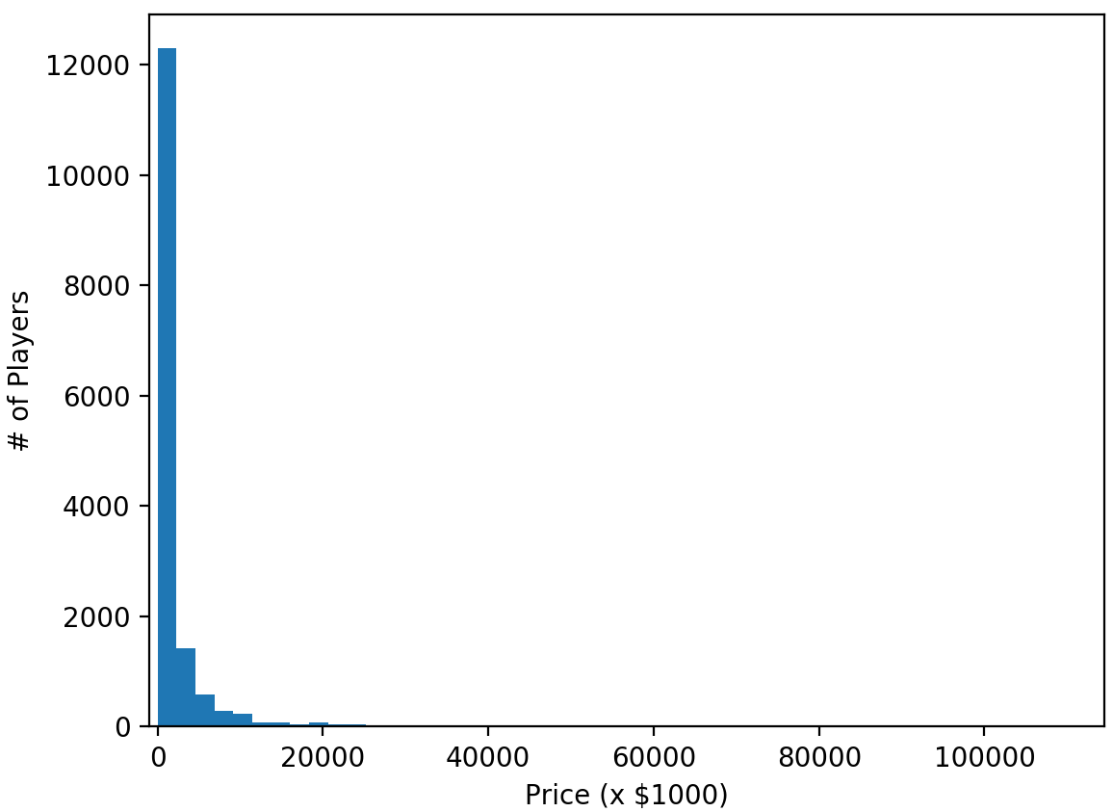
Prices
Most Common Price = $1.1M
Occur as quantized values except for a few outliers
Rounded Min Price = $43K
Rounded Max Price = $37M
Rounded and Categorized
Original Bottom-Heavy Prices

Slide 10
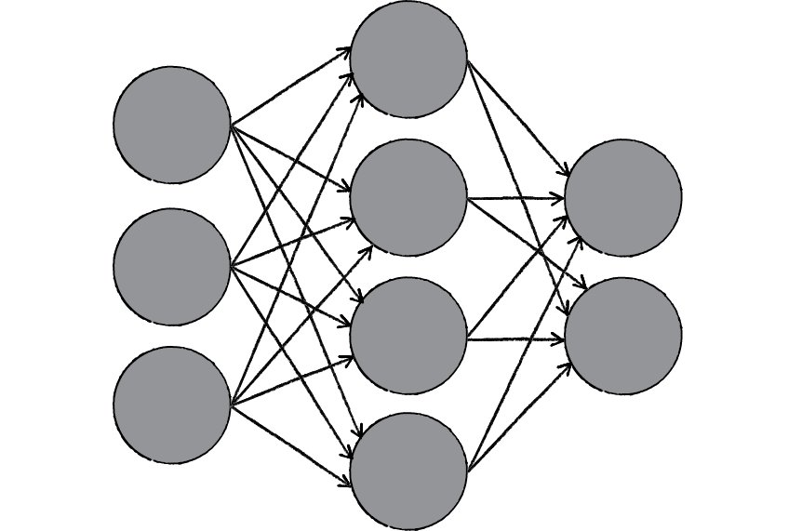
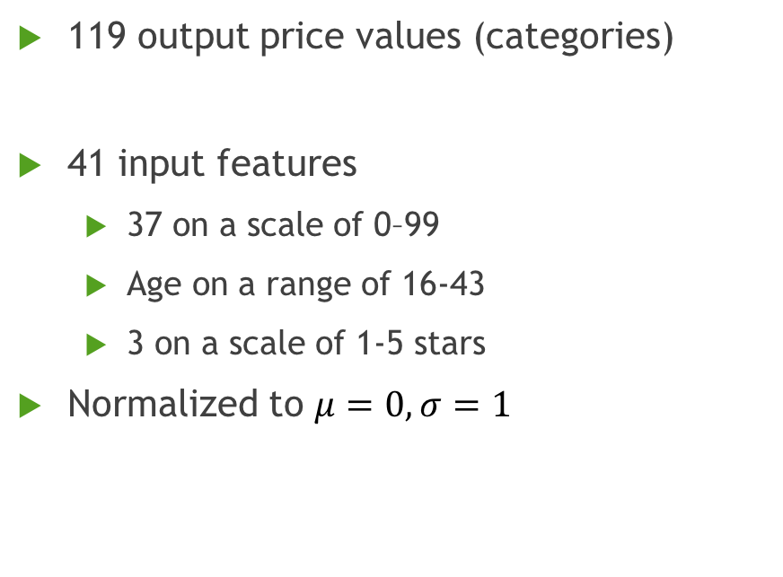
Network Structure
?
119 output price values (categories)
41 input features
37 on a scale of 0–99
Age on a range of 16-43
3 on a scale of 1-5 stars
Normalized to $μ=0, σ=1$
.
.
.
x41
.
.
.
x119

Slide 11
Data Splits
Test: 16%
2500 samples
Validation: 13%
1926 samples
Total:
15340 players
Training: 71%
10914 samples

Slide 12
Network Experiments
Activation functions
Number and size of hidden layers
Learning rate and its decay
Regularization (L2)
Nesterov Momentum
Early stopping to prevent overfitting

Slide 13
Activation Functions
ReLU for all hidden layers and softmax for output layer works best

Slide 14
Size of 1st Hidden Layer
No real trend. Max accuracy for 3900 neurons.
I picked 2000 neurons for final model after optimizing other parameters.

Slide 15

Learning rate $η$
Percentage Accuracy
Picked eta = 0.01
Number of neurons in 2nd hidden layer

Slide 16
Size of subsequent hidden layers
Network config = [41,2000,X,119]
Picked X = 1500
Network config = [41,2000,1500,X,119]
Picked X = 500
Final network configuration = [41,2000,1500,500,119]

Slide 17
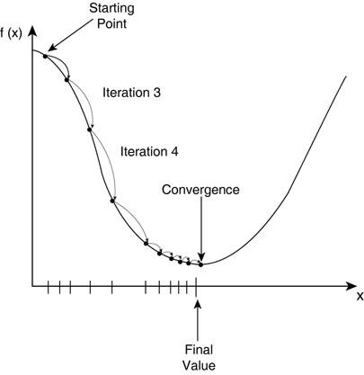
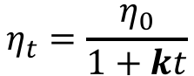
Learning rate decay (Annealing)
Percentage Accuracy
Picked k = 0.001
$$η_{t}=\frac{η_{0}}{1+kt}$$

Slide 18
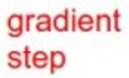
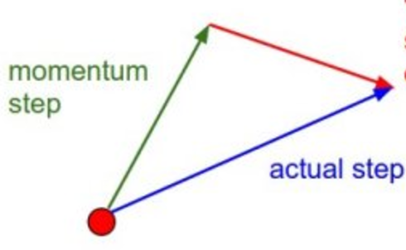
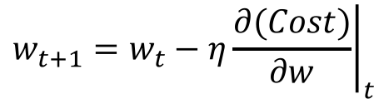
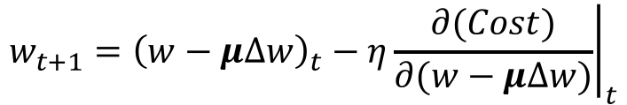
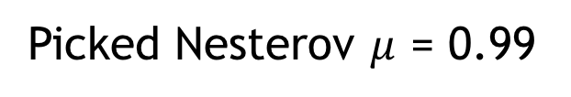
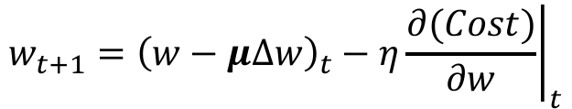
Nesterov Momentum
Ordinary Gradient Descent Update
$$w_{t+1}=w_{t}−η{\left.\frac{∂(Cost)}{∂w}\right|}_{t}$$
Momentum Update
$$w_{t+1}={\left(w−μ∆w\right)}_{t}−η{\left.\frac{∂(Cost)}{∂w}\right|}_{t}$$
Nesterov Momentum Update
$$w_{t+1}={\left(w−μ∆w\right)}_{t}−η{\left.\frac{∂(Cost)}{∂(w−μ∆w)}\right|}_{t}$$
Picked Nesterov $μ$ = 0.99

Slide 19
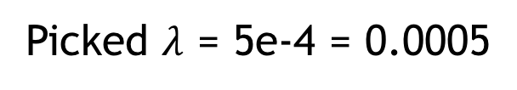
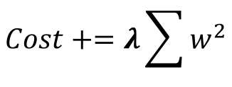
L2 Regularization
$$Cost+=λ\sum{w^{2}}$$
Percentage Accuracy
Picked $λ$ = 5e-4 = 0.0005

Slide 20
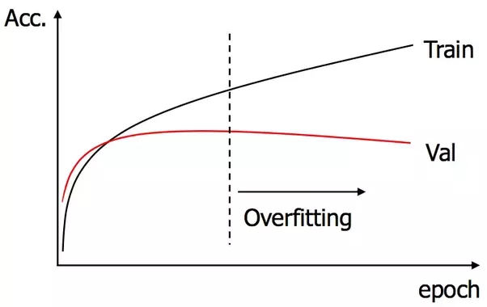
Early Stopping
Prevent overfitting by stopping training when validation accuracy doesn’t improve over some threshold number of epochs
Picked threshold = 10 epochs

Slide 21
Final Training Conditions
Network configuration = [41,2000,1500,500,119]
ReLU activation for all hidden layers, finally softmax output
L2 Regularization Coefficient = 0.0005
Learning rate = 0.01, annealing coefficient = 0.001
Nesterov momentum coefficient = 0.99
Minibatch size = 20
Early stopping at 60 epochs

Slide 22
Accuracy Metrics
(Top-1) Accuracy: Prediction exactly matches actual price
40.32%
Actual
Predicted
71.28%
Actual
Predicted
Top-3 Accuracy
87.2%
Actual
Predicted
Top-5 Accuracy

Slide 23
Average Percentage Error (APE) in Price
$$APE=\left({Avg}_{All Test Samples}{\frac{\left|True price−Predicted price\right|}{True price}}\right)×100$$
APE = 6.32%

Slide 24
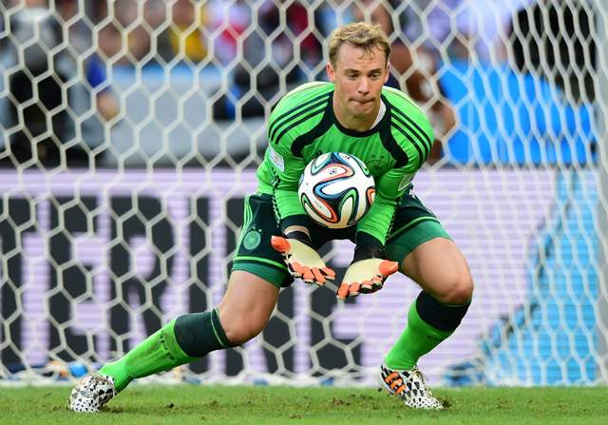

Potential Improvements
Star outliers hard to predict
Goalkeeping stats not considered
Training beyond ~60 epochs doesn’t improve
Vanishing gradients: Use different eta for each layer
Lionel Messi: $96 Million
Manuel Neuer: $75 Million

Slide 25
Additional Details
Accompanying report
More explanations
References
Code Available on Github
Tools Used
Python 2.7
Theano
Keras

Slide 26
Ending Quote
“
If you have the money and you find the one player who can make you win and make the difference, no matter how expensive he is, you should do it. But there are not many players in the world who will make a real difference.
”
-- Arsene Wenger
Manager, Arsenal Football Club
Interview with The Times, 2009

